Slide 1
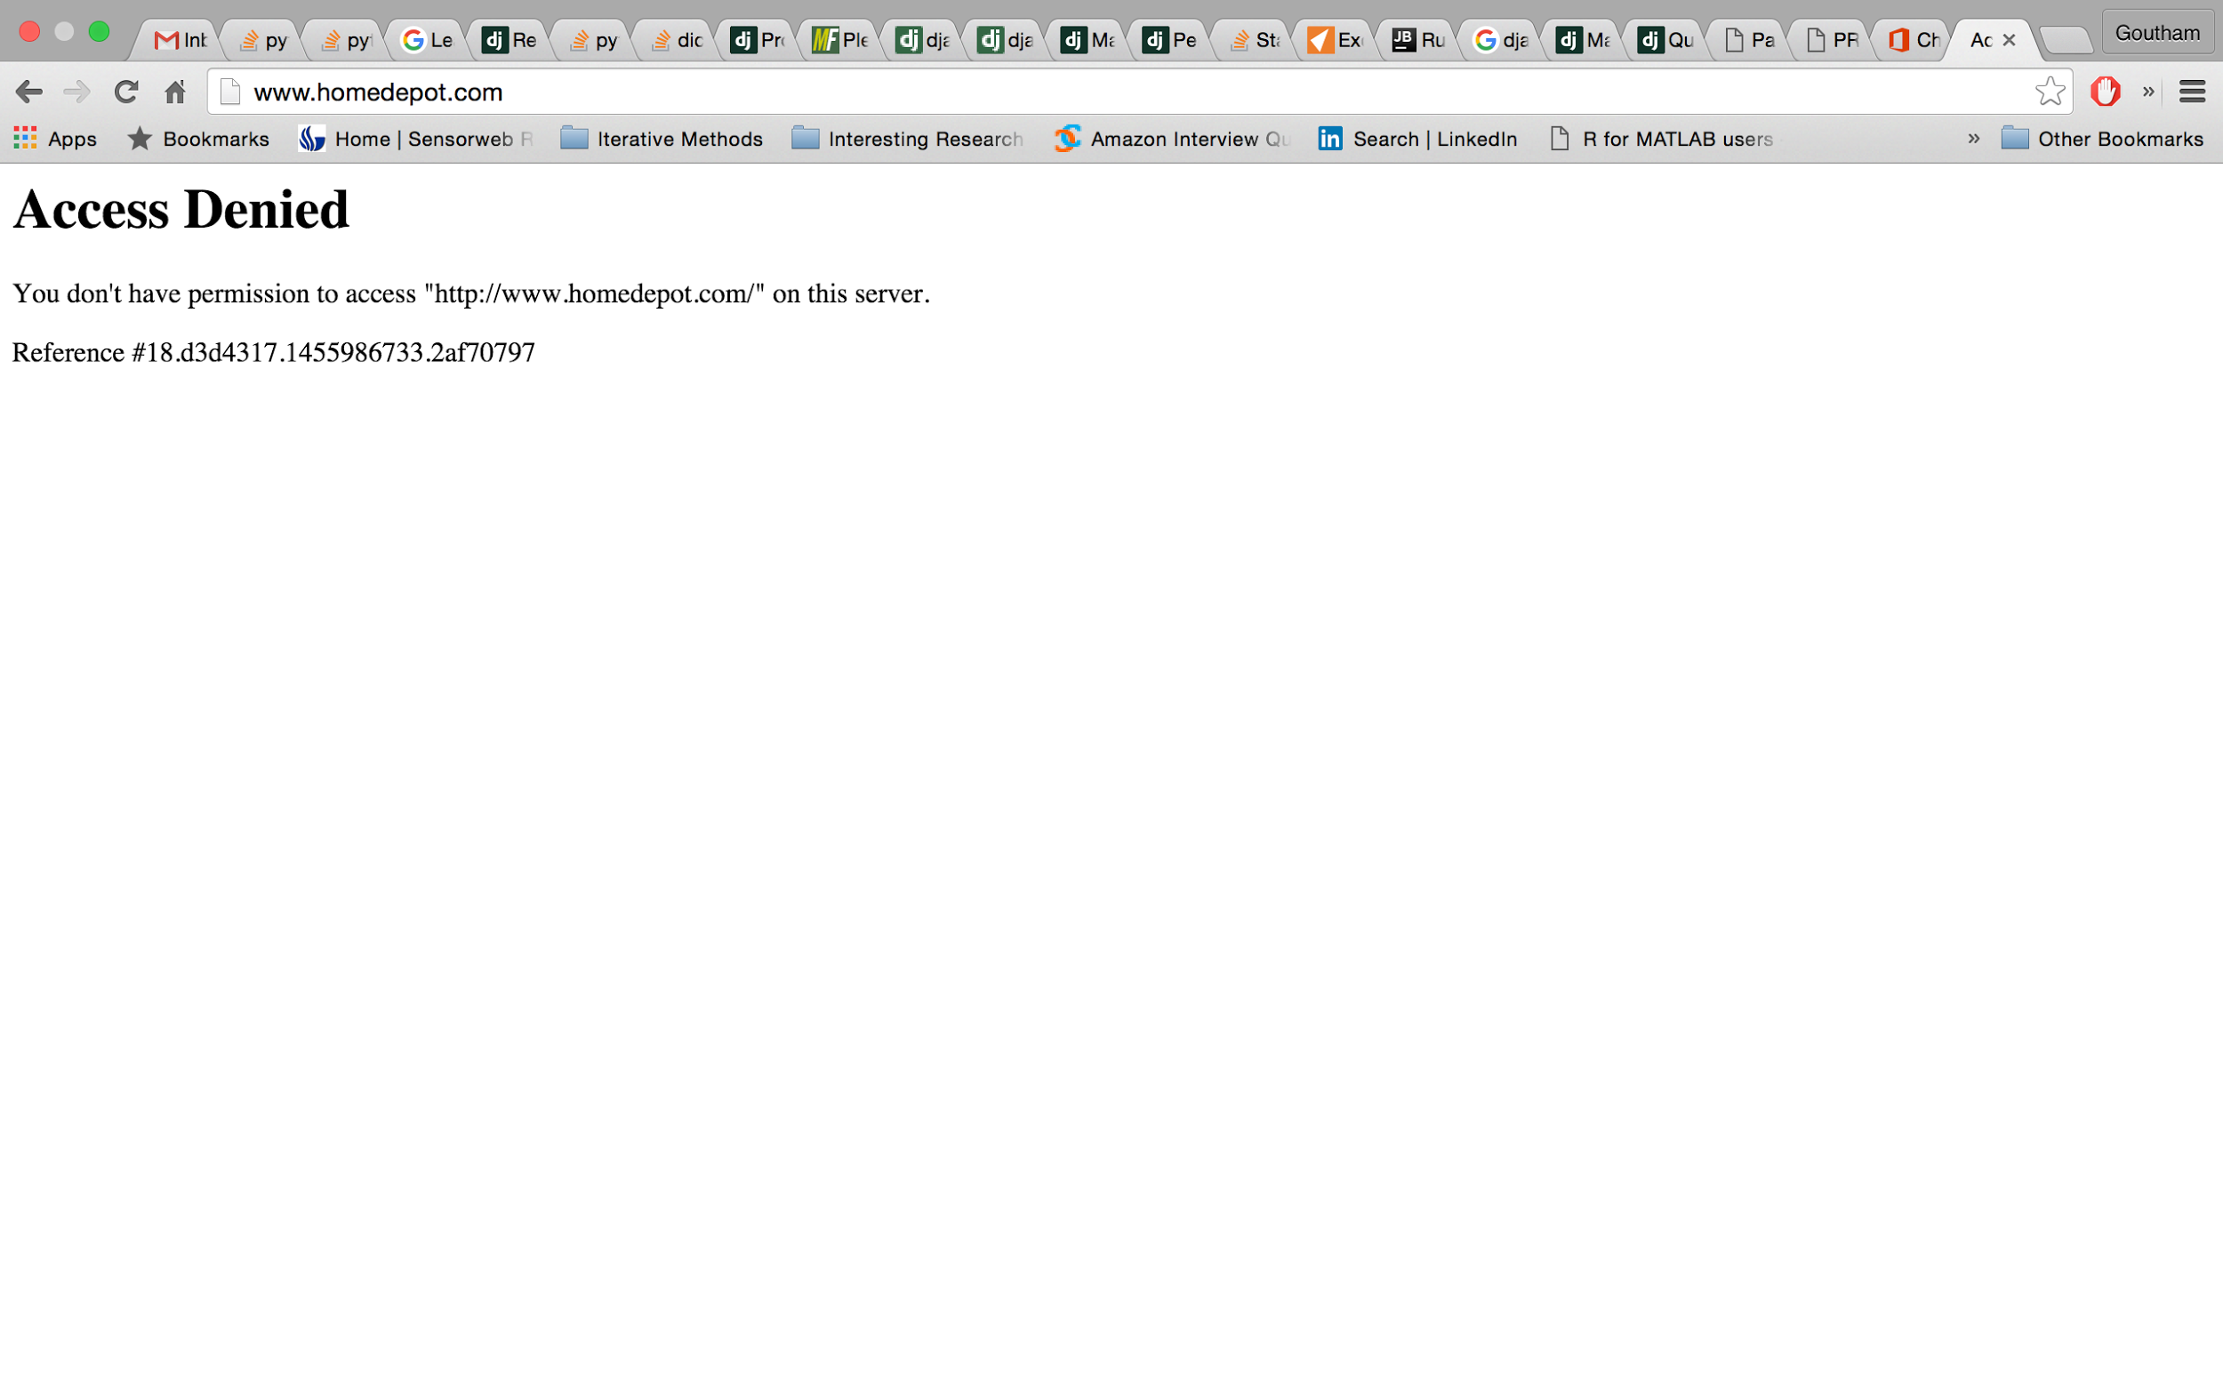
YES We Did it !!
Our IP was blocked by HomeDepot IT
We scrapped all their DIY website links, keywords, categories

Slide 2
How we got the data ?
We crawled HD website
Got 16 Categories (Appliance, Bath ..)
Got 260 DIY URLS
Got 2200 Keywords
Search query for bath
http://www.homedepot.com/c/how_to_replace_a_shower_head_HT_PG_BA
http://www.homedepot.com/c/bath_faucets_HT_BG_BA
http://www.homedepot.com/c/bathroom_remodeling_bathroom_vanity_and_vanity_sinks_HT_BG_BA
http://www.homedepot.com/c/how_to_replace_a_center_set_faucet_HT_PG_BA
http://www.homedepot.com/c/choosing_the_right_shower_door_HT_BG_BA
http://www.homedepot.com/c/how_to_professionally_remove_a_bath_tub_HT_PG_BA
http://www.homedepot.com/c/bathtubs_whirlpool_tubs_walk_in_tubs_buying_guide_HT_BG_BA
http://www.homedepot.com/c/bath_fans_HT_BG_BA

Slide 3
IndigoApp
A Customer comes to HomeDepot Store
He goes to kiosk or handheld device
He has 3 choices
Today he is here to select a ProCustomer
He wants to talk to an associate
He wants to look up DIY Projects

Slide 4
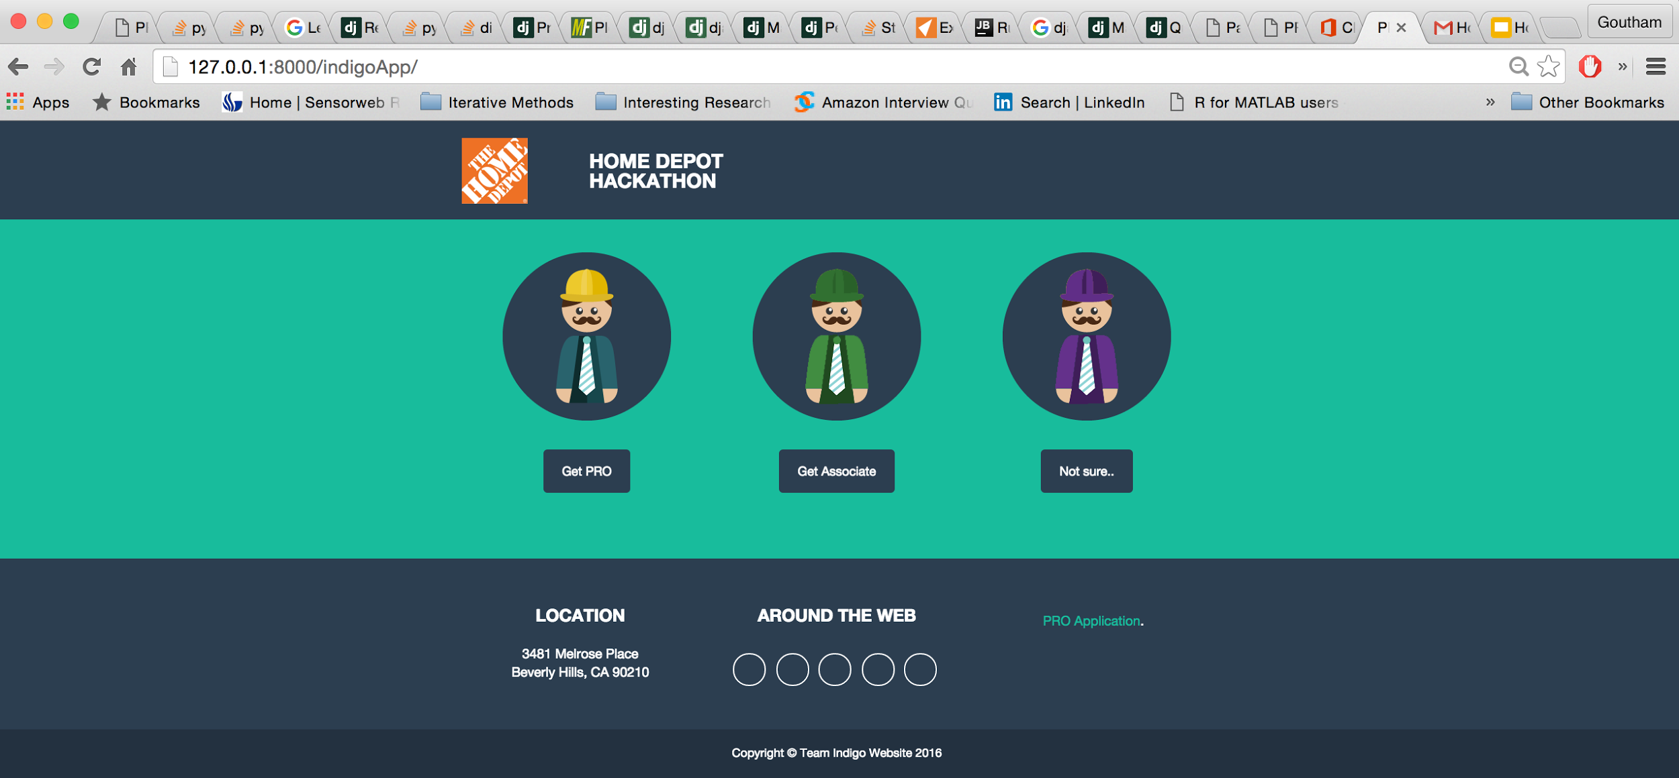

Slide 5
Tools Used
Front End - BootStrap (CSS,Jquery,Js,HTML)
Django Framework
SQlite3 Database
Git
Stackoverflow
Caffiene

Slide 6
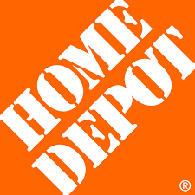
Design
Indigo
Django Server
Python Backend/views
HTTP Req/Res
SQLite Database
Web Scraper

Slide 7
Database Design
CustomerTable
UserID | CompanyName | IsPro | Password | Rating | IsAvailable
CategoryUrlMap
KeyWord | Category | URL
CategoryUserMap
Category | UserID

Slide 8
FuzzyWuzzy
If keywords not matched exactly ?
Used fuzzysearch module in python
Got the nearest keyword and mapped !!
If fuzzy could not match then
Redirect them to http://homedepot.com/s/keyword

Slide 10
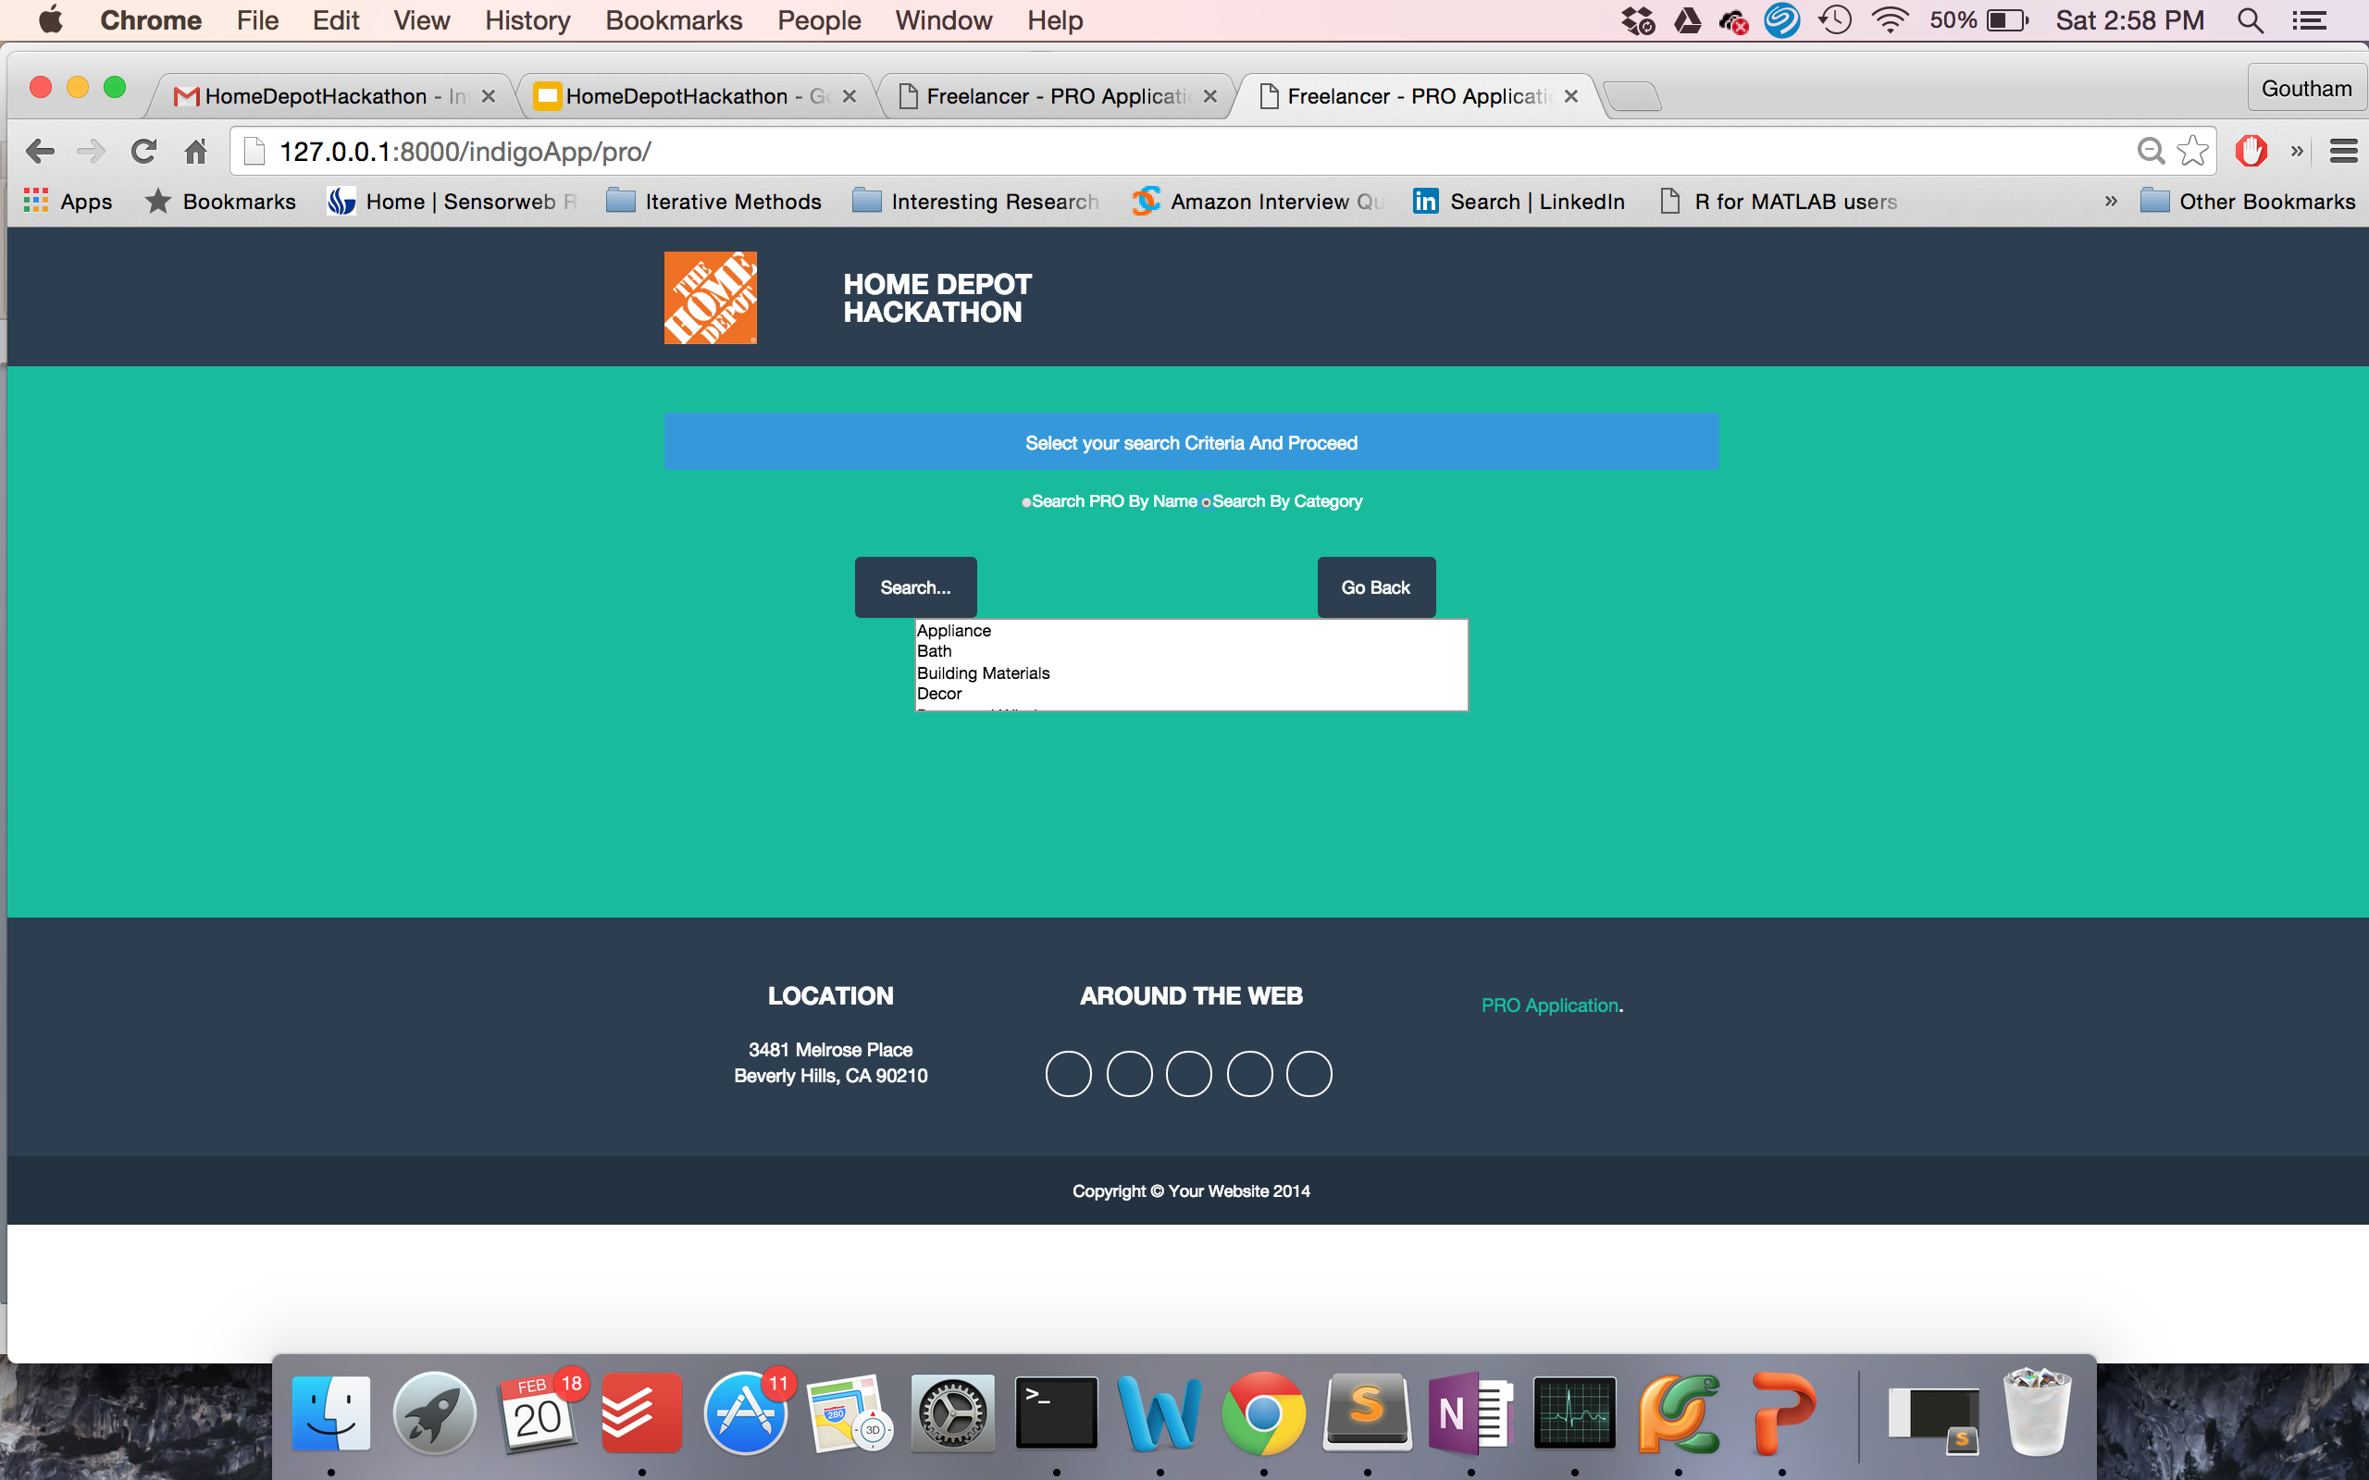

Slide 11
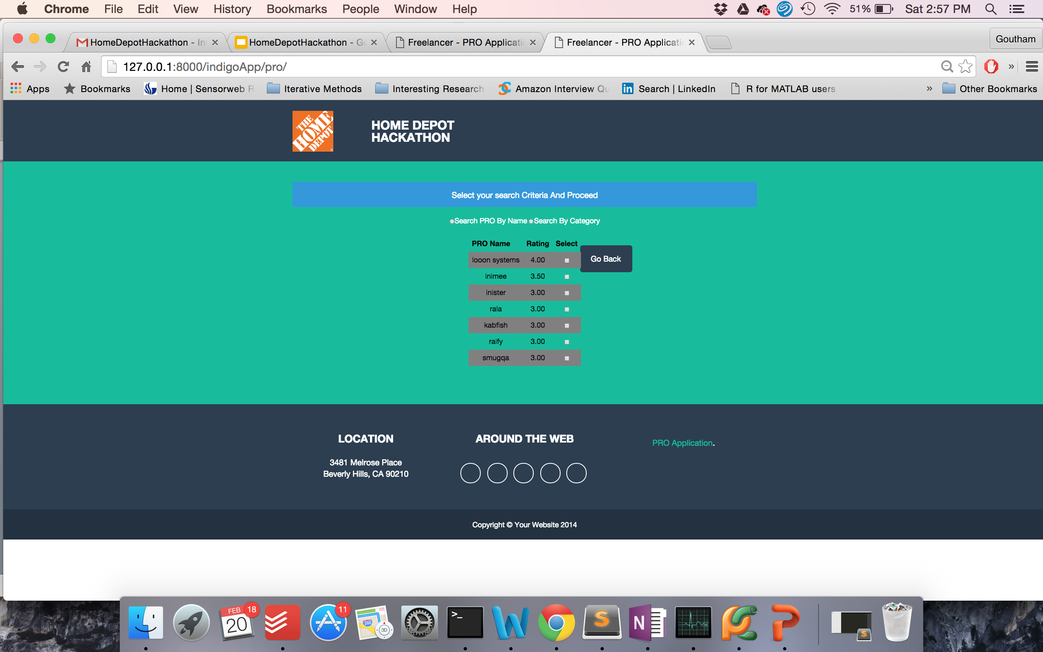

Slide 12
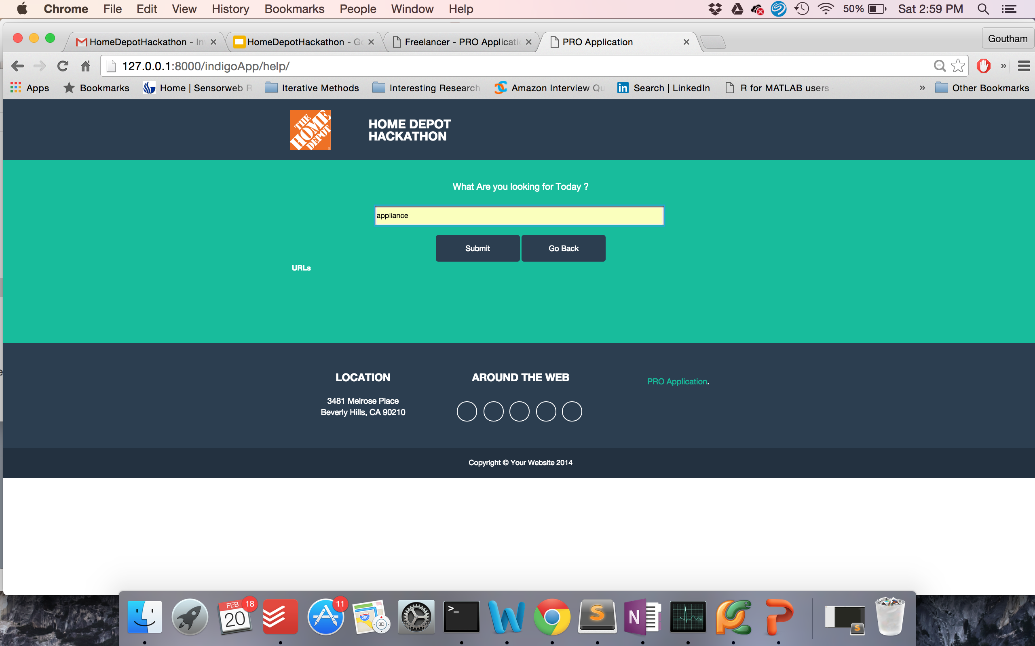

Slide 13
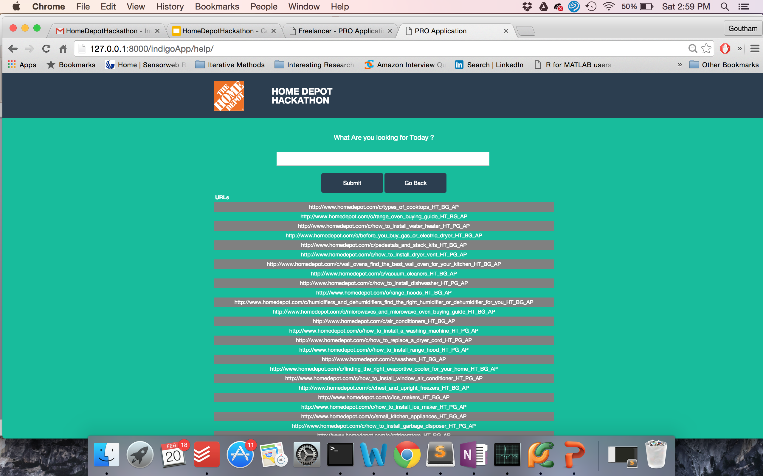

Slide 14
Django Unchained !!

